Slide 1

WELCOME

Slide 2
Project Members :
Prashant Patil
Vishal Bone
Surya Teja
Sonali Gavhane

Slide 3
Project on Employee Records
Problem Statement-
Using file handling employees record is to be create in three files like first file contains Details of employees, second file contains department details and third file contains project details.
Then details of employee is to be search as per requirement.

Slide 4
Objective-
To create three files containing employee records using file handling in C#
First file will contain Employee details such as emp id, dep id, emp name, phone no , email id.
Second file will contain Department details such as dept name, dept id, no of projects etc.
Third file will contain project details such as project id, dept id , project name, employee id.
And also there will be search function to search the details as per requirement.

Slide 5
User has to enter choice -
1 Employee Record
2 Department Record
3 Project Record
4 Display Employee Record
5 Display Department Record
6 Display project Record
7 Insert in to the Employee File
8 Insert in to the Department File
9 Insert in to the Project File
10 Get project Info by Employee ID
11 Get Employee Info by Depart ID
12 Exit

Slide 6
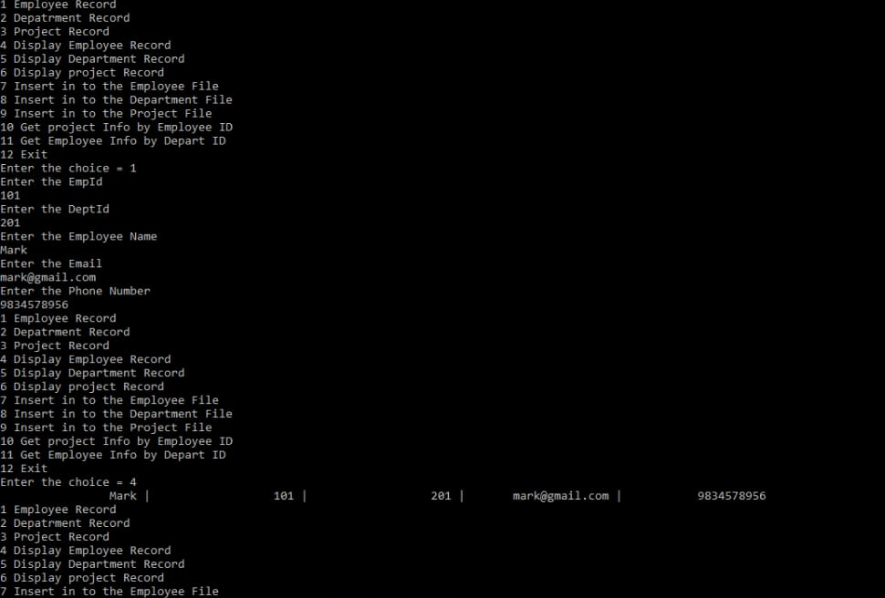
Here are some snaps of output window

Slide 7
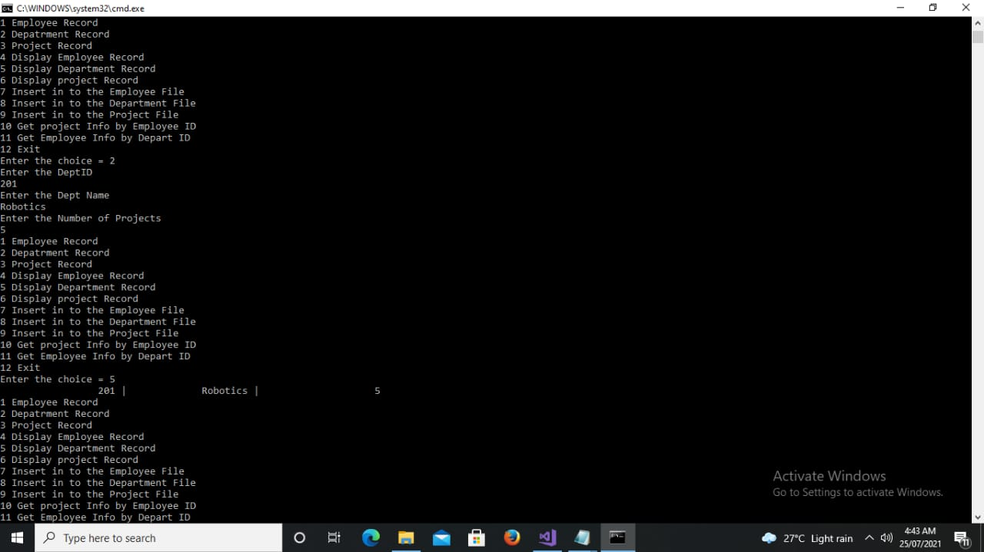

Slide 8
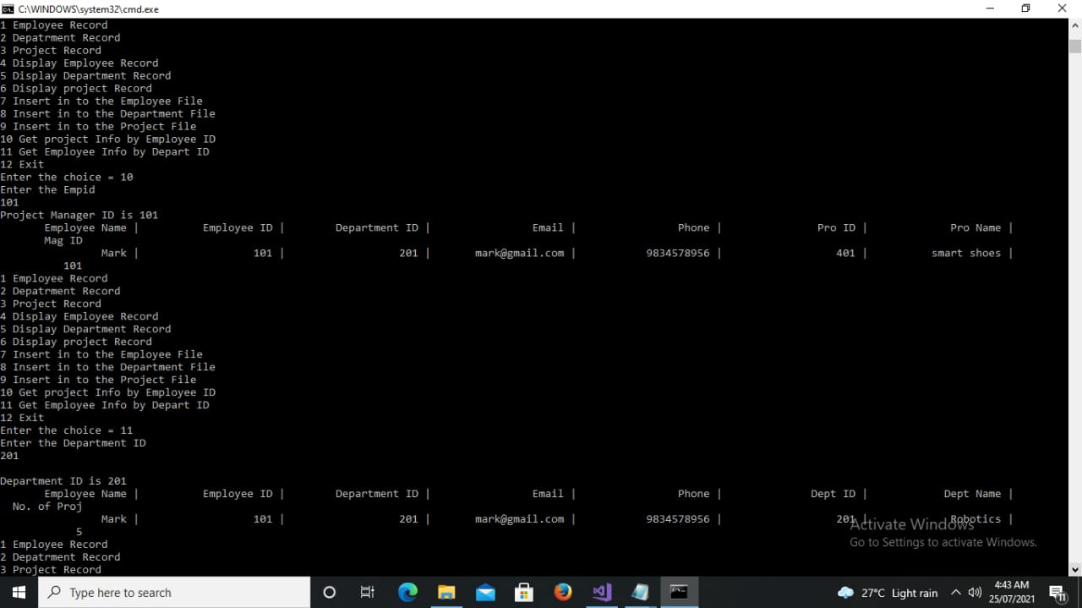

Slide 10
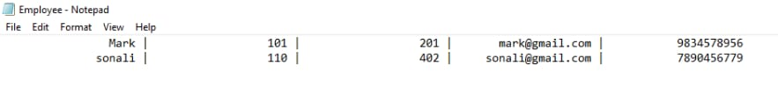


Here are some snaps of files

Slide 11
Thank You

